Slide 1
ISTQB Foundation Level

Slide 2
Topics
1 | Fundamentals of Testing
2 | Testing throughout the Software life cycle
3 | Static Techniques
4 | Test Design Techniques
5 | Test Management
6 | Tools support for testing

Slide 3
1. FUNDAMENTALS OF TESTING

Slide 4
Fundamentals of Testing
FUNDAMENTALS OF TESTING
Testing is a process that gives insight in and advises on the Quality and the related Risks.
Why is Testing Necessary
What is Testing?
Seven testing Principles
Fundamental Test process
The Psychology of testing
Code of Ethics
Notes:
Testing: The process of all life cycle activities both static and dynamic, Concerned with planning, preparation and evaluation of software product and related work product to determine that they satisfy the specified requirement to demonstrate that they are fit fir purpose and to detect defects.

Slide 5
Why is Testing Necessary?
FUNDAMENTALS OF TESTING
Because software is likely to have faults
To learn about the reliability of the software
To fill the time between delivery of the software and the release date
To prove that the software has no faults
Because testing is included in the project plan
Because failures can be very expensive
To avoid being sued by customers
To stay in business

Slide 6
Error - Defect - Failure
FUNDAMENTALS OF TESTING
Error(Mistake):
A human action that produces an incorrect result
Defect(Bug, Fault):
A manifestation of an error in software also known as a defect or bug, if executed, a fault may cause a failure
Failure:
Deviation of the software from its expected delivery or service (found defect)
A person makes
an error ...
… that creates a fault in the software ...
… that can cause a failure in operation
Notes:
New slide added

Slide 7
Why do faults occur in software & some examples of the related cost
FUNDAMENTALS OF TESTING
Software is written by human beings
Who know something, but not everything
Who have skills, but aren’t perfect
Who do make mistakes (errors)
Under increasing pressure to deliver to strict deadlines
No time to check but assumptions may be wrong
Systems may be incomplete
Environmental conditions
Radiations, Magnetism, Electronic fields and pollution can cause faults in firmware or influence execution of software by changing hardware conditions
Software that does not work correctly can lead to many problems including loss of money, time, business reputation & could even cause injury or death.
Few examples;
Ariane 5 Space Program ($7billion)
Mariner space probe to Venus ($250m)
American Airlines ($50m)
Notes:
Software: Computer Program, Procedures and possibly associated documentation and data pertaining to the operations of a computer.
Debugging: The process of finding, analyzing and removing the cause of failures in software

Slide 8
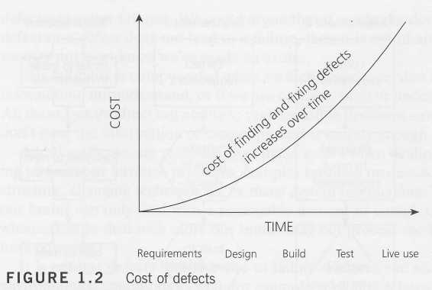
Cost of defects:
FUNDAMENTALS OF TESTING
It is Easy to find and fix defect in early stages rather than in the later phases of software.
Notes:
New slide added

Slide 9
What is Testing ?
FUNDAMENTALS OF TESTING
Testing is a process that helps in finding out how well the product works.
Aimed at finding defects
Aimed at demonstrating lack of quality
Aimed at demonstrating the gap between specifications and actual product
Aimed at building faith in the end product that gives advise on quality and risk
Notes:
Quality: The degree to which a component system or process meets specified requirements and/or user/customer needs and expectation.

Slide 10
Seven Testing Principles ?
FUNDAMENTALS OF TESTING
Principle 1 –It shows presence of defects but cannot prove that there are no defects
Principle 2 – Exhaustive testing is impossible. Risk analysis & prioritisation should be used to focus testing effort.
Principle 3 – To find defects early, testing activity shall be started as early as possible in the SDLC
Principle 4 – Testing effort should be focused proportionally to the expected or later observed defect density of modules. A small number of modules usually contains most of the defects.
Principle 5 – If same set of tests are repeated, then NO defects found. To overcome this “Pesticide Paradox” test cases need to be reviewed and revised regularly to assess different parts of the software or systems.
Principle 6 – Testing is context dependent.
For example , Safety Critical Software is tested differently.
Similarly software for an e-commerce application would be tested differently from different points of access
Principle 7 – Finding & fixing of errors does not help if the system built is unusable and does not fulfil the users’ needs and expectations.

Slide 11
Fundamental Test Process
FUNDAMENTALS OF TESTING
The fundamental test process consists of the following activities:
Test planning and control
It defines the objectives and specification of test activities.
Test control is the ongoing activity of comparing actual progress against the plan.
Test analysis and design
General testing objectives are transformed into tangible test conditions and test cases
Reviewing the test basis
Evaluating testability of the test basis and test objects
Identifying and Prioritizing test conditions based on analysis of test item, the specification, behaviour and structure of the software
Designing and Prioritizing test conditions based on analysis of the test items, the specifications, behaviour and structure of the software
Designing and Prioritizing high level test cases
Identifying necessary test data to support the test conditions and test cases.
Designing the test environment setup and identifying any required infrastructure and tools
Creating bi-directional traceability between test basis and test cases.
Notes:
Coverage: The degree, expressed as a percentage to which a specified coverage item has been exercised by a test suite.
Test Suite: A set of several test cases for a component or system under test, where the post condition of one test is often used as the precondition for the next one.

Slide 12
Fundamental Test Process
FUNDAMENTALS OF TESTING
Test implementation and execution
Test procedures or scripts are specified by combining the test cases in a particular order and including any other information needed for test execution, the environment is set up and tests are run.
Finalizing, implementing and prioritizing test cases
Developing and prioritizing test procedures, creating test data and optionally preparing test harness and writing automated test scripts
Creating test suites from the test procedures for efficient test execution
Verification of Test environment is setup correctly
Verifying and updating bi-directional traceability between test basis and test cases
Executing test procedure using tool or manually according to the planned sequence
Logging the outcome of the test execution and recording the identities and version of the software under test tools and test ware
Comparing actual result with the expected result
Reporting discrepancies and analysing their root cause
Repeating test activities as a result of action taken for each discrepancy
Notes:
Test Execution: The process of running a test by the component or system under test, producing actual result

Slide 13
Fundamental Test Process
FUNDAMENTALS OF TESTING
Evaluating exit criteria and reporting
Test execution is assessed against the defined objectives.
Test logs and checked against the exit criteria specified in test planning.
Assessment is done if more tests are needed.
Test summary report is written.
Test closure activities
Data from completed test activity is collected to consolidate experience, facts and numbers.
This is done at milestones.
Notes:
Testware: Artifacts produced during the test process required to plan, design and execute test and any additional software or utilities used in testing.

Slide 14
Re-testing (Confirmation Testing)
FUNDAMENTALS OF TESTING
Re-Running failed tests:
Must be exactly repeatable
Same environment, versions (except for the software which has been intentionally changed!)
Same inputs and preconditions
New faults introduced by the first
fault fix not found during re-testing
x
x
x
✓
Fault now fixed
x
Re-test to check
Notes:
New slide added

Slide 15
Regression testing
FUNDAMENTALS OF TESTING
To look for any unexpected side-effects
Regression tests are performed:
After software changes, including faults fixed
When the environment changes, even if application functionality stays the same
For emergency fixes (possibly a subset)
x
x
x
x
✓
Can’t guarantee
to find them all
Notes:
New slide added
Regression test suites
evolve over time
are run often
may become rather large
Maintenance of the regression test pack
eliminate repetitive tests (tests which test the same test condition)
combine test cases (e.g. if they are always run together)
select a different subset of the full regression suite to run each time a regression test is needed
eliminate tests which have not found a fault for a long time (e.g. old fault fix tests)
Regression testing and automation
Test execution tools (e.g. capture replay) are regression testing tools - they re-execute tests which have already been executed
Once automated, regression tests can be run as often as desired (e.g. every night)
Automating tests is not trivial (generally takes 2 to 10 times longer to automate a test than to run it manually
Don’t automate everything - plan what to automate first, only automate if worthwhile

Slide 16
The Psychology of Testing
FUNDAMENTALS OF TESTING
The mindset to be used while testing and reviewing is different from that used while developing software
Separation of responsibilities of development and testing are done to help focus efforts and provide an independent / unbiased view
While a certain level of independence often makes the tester more effective at finding defects and failures, this independence can however not replace familiarity which developers possess.
People and projects are driven by objectives. For example, to find defects and confirm that the software meets it objectives. It is therefore important to clearly state the objectives of testing.
Identifying failures during testing may be perceived as criticism against the product and its author. Testing is therefore often viewed as a destructive activity.
Communication of errors in the product in a constructive way therefore assumes particular importance in order to make testing appear constructive and supportive.
The Test Leaders and Testers therefore need to have good inter-personal and communication skills to overcome this difference of perception.
Some ways of improving communication and relationships between testers and others:
Start with collaboration rather than battles – Common goal of better quality system
Communicate findings in a neutral, fact-focussed way, without criticising individuals who created the tested products
Try to understand what the other person feels and why they react in the way they do
Confirm that the other person has understood what you conveyed.

Slide 17
Code of Ethics
FUNDAMENTALS OF TESTING
Involvement in software testing enables individuals to learn confidential and privileged information. A code of ethics is therefore necessary, among other reasons to ensure that the information is not put to inappropriate use.
The ISTQB® states the following code of ethics:
PUBLIC - CST shall act consistently with the public interest.
CLIENT AND EMPLOYER - CST shall act in a manner that is in the best interests of their client and employer, consistent with the public interest.
PRODUCT - CST shall ensure that the deliverables they provide (on the products and systems they test) meet the highest professional standards possible.
JUDGMENT - CST shall maintain integrity and independence in their professional judgment.
MANAGEMENT – CST managers and leaders shall subscribe to and promote an ethical approach to the management of software testing.
PROFESSION - CST shall advance the integrity and reputation of the profession consistent with the public interest.
COLLEAGUES – CST shall be fair to and supportive of their colleagues, and promote cooperation with software developers.
SELF - CST shall participate in lifelong learning regarding the practice of their profession and shall promote an ethical approach to the practice of the profession.

Slide 18
Sample Questions with answers

Slide 19
2. TESTING THROUGHOUT THE LIFECYCLE

Slide 20
2.1 Testing Throughout The Software Life Cycle
2.1 Software Development Models
Testing is not a stand-alone activity. It has its place within a software development life cycle model . The way testing is organized must fit the development life cycle. In any model part of testing is focused on Verification and a part is focused on Validation.
Verification: Is the deliverable built according to the specification?
Validation: Is the deliverable fit for purpose?
Various software development lifecycle models are
V-Model
Iterative life cycles
Rapid Application Development (RAD)
Dynamic System Development Methodology [DSDM]
Agile - Extreme Programming (XP)

Slide 21
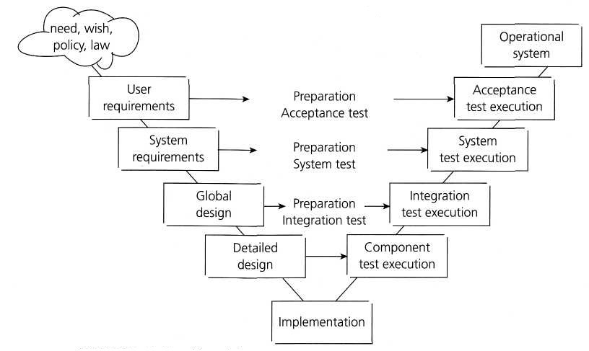
2.1.1 V - Model
2.1 Software Development Models

Slide 22
2.1.1 V – Model cntd…
2.1 Software Development Models
V-Model evolved from waterfall Model
Emphasis on starting testing activities early in software life cycle
Left side shows activities apart from testing
Right side shows Testing activities
Specific Testing activities are carried in parallel to development activities
The process steps are bent upwards after the coding/implementation phase
It consists of 4 test levels
Component Testing
Integration Testing
System Testing
Acceptance Testing

Slide 23
2.1.2 Iterative Life Cycles
2.1 Software Development Models
The delivery is divided into increments or builds
Each increment adds new functionality.
The initial increment will contain the infrastructure
Testing of the new functionality, regression testing, and integration testing are prominent test types performed
This life cycle can give early market presence with critical functionality
Simpler to manage because the workload is divided into smaller pieces
It may cost more in the long run
Iterative models are known as incremental development models
Examples are
Rapid Application Development (RAD)
Rational Unified Process (RUP)
Agile development

Slide 24
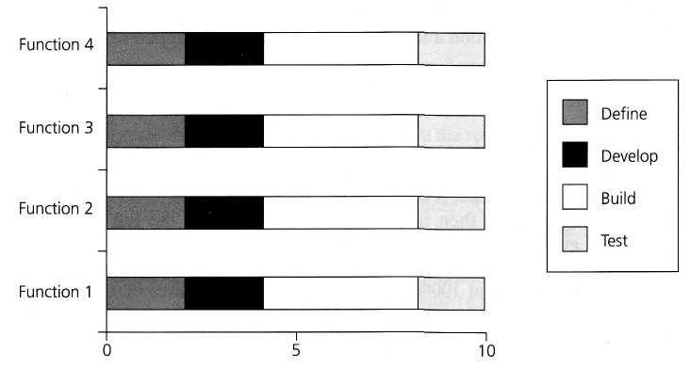
2.1.2 Rapid Application Development (RAD)
2.1 Software Development Models
Components are developed in parallel
The developments are time-boxed, delivered, and then assembled into a working prototype
Very quickly give the customer something to see and use
Rapid change and development of the product is possible
Allows early validation of technology risks
Rapid response to changing customer requirements is possible

Slide 25
2.1.2 Rational Unified Process (RUP) - Phases
2.1 Software Development Models
RUP is created by the Rational Software Corporation. Consisting of four phases and nine disciplines
Inception – The objective is to define scope the system. The business case which includes business context, success factors and financial forecast is established
Elaboration - The objective is to mitigate the key risk items. The problem domain analysis is made and the architecture of the project gets its basic form
Construction – The objective is to build the software system. The main focus is on the development of components of the system
Transition – The objective is to 'transit' the system from development into production. Activities include train the end users and beta testing the system
Notes:
The nine disciplines are performed iteratively throughout the four phases
Business Modeling– To understand the business of the organization, possibility of re-engineering business process is explored and potential strategies are evaluated
Requirements - The scope of the project is defined and specification documents for functional and non-functional requirements are prepared
Analysis and Design – The requirements are analyzed and architecture design of the system is made
Implementation – The program source code is developed and unit testing is done
Test - This discipline ensures quality of the system developed. It consists of finding bugs, ensuring that the system works as per the design of the system and meets all requirements mentioned in the specification documents
Deployment - Includes planning and executing delivery of software and supporting documentations ready to be deployed and making the system available to end users
Configuration and Change Management – This includes managing baselines of the project, accepting and managing change requirements, changing and delivering configuration items and managing releases
Project management - This includes assigning tasks, managing risks, tracking progress etc to ensure on time and within budget delivery of the product
Environment – This includes ensuring proper tools are available whenever required

Slide 26
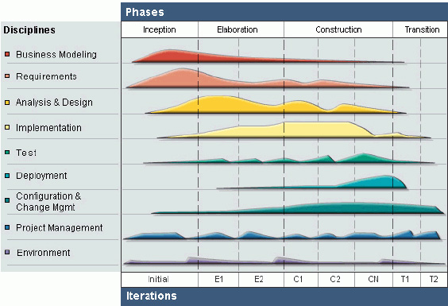
2.1.2 RUP Phases and Disciplines
2.1 Software Development Models

Slide 27
2.1.2 Agile Development – Extreme Programming (XP)
2.1 Software Development Models
XP is currently one of the most well-known agile development life cycle models. Some characteristics of XP are:
It promotes the generation of business stories to define the functionality
It demands an on-site customer for continual feedback and to define and carry out functional acceptance testing
It promotes pair programming and shared code ownership amongst the developers
It states that component test scripts shall be written before the code is written and that those tests should be automated
It states that integration and testing of the code shall happen several times a day
It states that we always implement the simplest solution to meet today's problems

Slide 28
2.2.1 Component Testing
2.2 Test Levels
To conduct effective and efficient testing various Test levels are introduced. Below are the Test levels
Component Testing
Integration Testing
System Testing
Acceptance Testing
Component Testing
It is also known as unit, module and program testing
It searches for defects in, and verifies the functioning of software (e.g. modules, programs, objects, classes, etc.) that are separately testable
Stubs and drivers are used to replace the missing software
Defects are typically fixed as soon as they are found, without formally recording the incidents found
Test-first approach or test-driven development – Automated Test cases are written before coding

Slide 29
2.2.2 Integration Testing
2.2 Test Levels
Testing of interfaces between components, interactions to different parts of a system
Component integration testing tests the interactions between software components and is done after component testing
System integration testing tests the interactions between different systems and done after system testing
May be carried out by the developers, but can be done by a separate team of specialist integration testers
Below are different types of Integration Testing
Big-bang testing
Top-down
Bottom-up
Functional incremental
Notes:
Bing-bang - All components or systems are integrated simultaneously, after which everything is tested as a whole.
Top-down: testing takes place from top to bottom, following the control flow or architectural structure (e.g. starting from the GUI or main menu). Components or systems are substituted by stubs.
• Bottom-up: testing takes place from the bottom of the control flow upwards. Components or systems are substituted by drivers.
• Functional incremental: integration and testing takes place on the basis of the functions or functionality, as documented in the functional specification.

Slide 30
2.2.3 System Testing
2.2 Test Levels
Is concerned with the behavior of the whole system/product
It is carried out by specialist testers
Should test both functional and non-functional requirements of the system
Conducted by the development organization in a properly controlled environment
The test environment should correspond to production environment as much as possible

Slide 31
2.2.4 Acceptance Testing
2.2 Test Levels
It is performed by user or customer after System Test is complete
The goal is to establish confidence in the system
The test environment must correspond to production environment
There are various types of Acceptance Testing
User Acceptance Testing
Operational Acceptance Test / Production Acceptance Test
Contract Acceptance Testing
Compliance acceptance testing / Regulation Acceptance Testing
Alpha Testing
Beta Testing
Notes:
User Acceptance Testing (UAT) - Focuses mainly on the functionality thereby validating the fitness-for-use and is performed by the users and application managers
Operational Acceptance Test / Production Acceptance Test - Validates whether the system meets the requirements for operation and may include testing of backup/restore, disaster recovery, maintenance tasks and periodic check of security vulnerabilities
Contract Acceptance Testing - Is performed against a contract's acceptance criteria for producing custom-developed software
Compliance acceptance testing / Regulation Acceptance Testing - Is performed against the regulations which must be adhered to, such as governmental, legal or safety regulations.
Alpha Testing – It is performed at the developer's site by a cross-section of potential users and members of the developer's organization
Beta Testing - It is performed by a cross-section of users who install it and use it under real-world working conditions

Slide 32
2.3 Test Types
2.3 Test Types
Test Types are introduced as a means of clearly defining the objective of a certain test level for a program or project. A test type is focused on a particular test objective.
Testing of function (functional testing)
Testing of software product characteristics (non-functional testing)
Testing of software structure/architecture (structural testing)
Testing related to changes (confirmation and regression testing)
Notes:
User Acceptance Testing (UAT) - Focuses mainly on the functionality thereby validating the fitness-for-use and is performed by the users and application managers
Operational Acceptance Test / Production Acceptance Test - Validates whether the system meets the requirements for operation and may include testing of backup/restore, disaster recovery, maintenance tasks and periodic check of security vulnerabilities
Contract Acceptance Testing - Is performed against a contract's acceptance criteria for producing custom-developed software
Compliance acceptance testing / Regulation Acceptance Testing - Is performed against the regulations which must be adhered to, such as governmental, legal or safety regulations.
Alpha Testing – It is performed at the developer's site by a cross-section of potential users and members of the developer's organization
Beta Testing - It is performed by a cross-section of users who install it and use it under real-world working conditions

Slide 33
2.3.1 Testing of Function (Functional Testing)
2.3 Test Types
Functional testing considers the specified behavior and is often also referred to as black-box testing
Function (or functionality) testing can, based upon ISO 9126, be done focusing on suitability, interoperability, security, accuracy and compliance
Experienced-based techniques can also be used
Testing functionality can be done from two perspectives:
Requirements-based testing uses a specification of the functional requirements for the system as the basis for designing tests
Business-process-based testing uses knowledge of the business processes
Notes:
User Acceptance Testing (UAT) - Focuses mainly on the functionality thereby validating the fitness-for-use and is performed by the users and application managers
Operational Acceptance Test / Production Acceptance Test - Validates whether the system meets the requirements for operation and may include testing of backup/restore, disaster recovery, maintenance tasks and periodic check of security vulnerabilities
Contract Acceptance Testing - Is performed against a contract's acceptance criteria for producing custom-developed software
Compliance acceptance testing / Regulation Acceptance Testing - Is performed against the regulations which must be adhered to, such as governmental, legal or safety regulations.
Alpha Testing – It is performed at the developer's site by a cross-section of potential users and members of the developer's organization
Beta Testing - It is performed by a cross-section of users who install it and use it under real-world working conditions

Slide 34
2.3.2 Testing of Non-functional Software Characteristics (Non-functional Testing)
2.3 Test Types
It is the testing of the quality characteristics, or non-functional attributes of the system
It includes performance testing, load testing, stress testing, security testing, usability testing, maintainability testing, reliability testing and portability testing etc
ISO has defined 6 quality characteristics [ISO/IEC 9126, 2001] and the subdivision of each quality characteristic into a number of sub-characteristics
Notes:
User Acceptance Testing (UAT) - Focuses mainly on the functionality thereby validating the fitness-for-use and is performed by the users and application managers
Operational Acceptance Test / Production Acceptance Test - Validates whether the system meets the requirements for operation and may include testing of backup/restore, disaster recovery, maintenance tasks and periodic check of security vulnerabilities
Contract Acceptance Testing - Is performed against a contract's acceptance criteria for producing custom-developed software
Compliance acceptance testing / Regulation Acceptance Testing - Is performed against the regulations which must be adhered to, such as governmental, legal or safety regulations.
Alpha Testing – It is performed at the developer's site by a cross-section of potential users and members of the developer's organization
Beta Testing - It is performed by a cross-section of users who install it and use it under real-world working conditions

Slide 35
2.3.3 Testing of Software Structure/Architecture (Structural Testing)
2.3 Test Types
The target of testing is the structure of the system or component basically the system architecture
Structural testing is often referred to as 'white-box' or 'glass-box' because we are interested in what is happening 'inside the box‘
It’s the way of measuring the thoroughness of testing through the coverage of a set of structural elements or coverage items
It tends to be mostly applied at component and integration levels
At component level there is good tool support to measure code coverage
Notes:
User Acceptance Testing (UAT) - Focuses mainly on the functionality thereby validating the fitness-for-use and is performed by the users and application managers
Operational Acceptance Test / Production Acceptance Test - Validates whether the system meets the requirements for operation and may include testing of backup/restore, disaster recovery, maintenance tasks and periodic check of security vulnerabilities
Contract Acceptance Testing - Is performed against a contract's acceptance criteria for producing custom-developed software
Compliance acceptance testing / Regulation Acceptance Testing - Is performed against the regulations which must be adhered to, such as governmental, legal or safety regulations.
Alpha Testing – It is performed at the developer's site by a cross-section of potential users and members of the developer's organization
Beta Testing - It is performed by a cross-section of users who install it and use it under real-world working conditions

Slide 36
2.3.4 Testing Related to Changes: Re-testing and Regression Testing
2.3 Test Types
The target of testing is the testing of changes. It includes below Test Types
Confirmation testing (re-testing) – Re-execution of the test after defects are fixed. The test is executed in exactly the same way as it was the first time
Regression testing – Ensures that the software is not adversely affected by the changes and critical functionality of the software is still intact. Generally there will be a regression test suite or regression test pack and executed whenever the software changes
Notes:
User Acceptance Testing (UAT) - Focuses mainly on the functionality thereby validating the fitness-for-use and is performed by the users and application managers
Operational Acceptance Test / Production Acceptance Test - Validates whether the system meets the requirements for operation and may include testing of backup/restore, disaster recovery, maintenance tasks and periodic check of security vulnerabilities
Contract Acceptance Testing - Is performed against a contract's acceptance criteria for producing custom-developed software
Compliance acceptance testing / Regulation Acceptance Testing - Is performed against the regulations which must be adhered to, such as governmental, legal or safety regulations.
Alpha Testing – It is performed at the developer's site by a cross-section of potential users and members of the developer's organization
Beta Testing - It is performed by a cross-section of users who install it and use it under real-world working conditions

Slide 37
2.4 Maintenance Testing
2.4 Maintenance Testing
Testing done after the system is deployed or on existing system is called Maintenance testing
It is different from maintainability testing, which defines how easy it is to maintain the system
Will consist of two parts: Testing the changes, defects and Regression tests
Impact and risk analysis is important activity performed to determine Test efforts
It is triggered by planned modifications, Ad-hoc corrective modifications, migration, or retirement of the system
Notes:
User Acceptance Testing (UAT) - Focuses mainly on the functionality thereby validating the fitness-for-use and is performed by the users and application managers
Operational Acceptance Test / Production Acceptance Test - Validates whether the system meets the requirements for operation and may include testing of backup/restore, disaster recovery, maintenance tasks and periodic check of security vulnerabilities
Contract Acceptance Testing - Is performed against a contract's acceptance criteria for producing custom-developed software
Compliance acceptance testing / Regulation Acceptance Testing - Is performed against the regulations which must be adhered to, such as governmental, legal or safety regulations.
Alpha Testing – It is performed at the developer's site by a cross-section of potential users and members of the developer's organization
Beta Testing - It is performed by a cross-section of users who install it and use it under real-world working conditions

Slide 38
Sample Questions with answers

Slide 39
3. STATIC TECHNIQUES

Slide 40
Chapter 3 – Static Techniques (K2)
STATIC TECHNIQUES
The Chapter covers:
3.1 - Static Techniques and the Test Process
3.2 - Review Process
3.3 – Static Analysis by Tools

Slide 41
3.1 Static Techniques and the Test Process
STATIC TECHNIQUES
How can we evaluate or analyze a requirements document, a design document, a test plan, or a user manual or examine a source code?
➔ By reviewing those.
These static techniques rely on manual examinations (Reviews) and automated Analysis (Static Analysis) without execution
Any software product can be reviewed
Purpose of reviews
- Finding defects
- informational, communicational and educational

Slide 42
Static Techniques and the Test Process continued..
STATIC TECHNIQUES
Types of defects found during static reviews:
Deviations from standard
Requirement defects
Design defects
Insufficient maintainability
Incorrect interface specification
Benefits of Reviews:
Early feedback on quality
Development productivity improvement
Reduced development timescales
Reduced testing time and cost
Lifetime cost reductions
Reduced fault levels
Increased awareness of quality issues
Requirements
Accept. Test
Functions
System Test
Design
Integration Test
Code
Unit Test
Reviews can help find defects in these phases

Slide 43
3.2 Review Process
STATIC TECHNIQUES
Activities of a formal review
Planning
Kick off
Individual Preparation
Examination/recording of results
Rework
Follow up
Responsibilities:
Manager: decides on the execution of reviews, allocates time in project schedules and determines whether review process objectives have been met
The moderator : Leads the review process. Determines, in co-operation with the author, the type of review, approach and the composition of the review team. The moderator performs the entry check and the follow-up on the rework

Slide 44
3.2 Review Process
STATIC TECHNIQUES
Responsibilities continued..
Author: The author of the document/code himself. His task is to illuminate unclear areas and to understand the defects
found
The scribe: During the logging meeting, the scribe (or recorder) has to record each defect mentioned and any suggestions for process improvement - can be the author himself.
The reviewers: Individuals with a technical and/or business background who identify the findings/defects.
In addition to the document under review, the material reviewers receive includes source documents, standards, checklists, etc.

Slide 45
3.2.3 Types of Review Process
STATIC TECHNIQUES
Informal Review:
No formal process
May take the form of pair programming or a technical lead review
Results may be documented
Varies in usefulness
Main advantage: inexpensive way
Walkthrough:
Meeting led by author
May take the form of scenarios, dry runs, peer group participation
Open-ended sessions - Optional pre-meeting preparation & review report creation
Main purpose: Learning, knowledge gaining, finding defects
Useful if people from outside the software discipline are present, who are not used to software development documents
Particularly useful for higher-level documents, such as requirement specifications and architectural documents

Slide 46
3.2.3 Types of Review Process
STATIC TECHNIQUES
Technical review:
Focuses on achieving consensus about the technical content of a document.
Ideally led by a moderator – not the author
Preparation of review report with recommendations
Optional use of checklists, issue log
Inspection:
Most formal review type
The document under inspection is prepared and checked thoroughly by the reviewers before the meeting
Led by the moderator
Includes metrics gathering
Entry and exit criteria
Rules and checklists are used during the preparation phase.
The defects found are documented in a logging list or issue log.
A formal follow-up is carried out by the moderator applying exit criteria

Slide 47
3.2.4 Review Process Success Criteria
STATIC TECHNIQUES
Success factors for reviews:
Review should be with clear objective
Defects found are welcomed and expressed objectively
Management supports a good review process
The emphasize is on learning and process improvement
The right people for review are involved
Appropriate use of review techniques
Reviews are conducted in a fair & trustworthy atmosphere
Explicitly planning and tracking review activities
Train the participants in the review techniques – particularly the formal ones such as inspection

Slide 48
3.3 Static Analysis By Tools
STATIC TECHNIQUES
Static analysis is just another form of testing but differs significantly from dynamic testing:
Static analysis is performed on requirements, design or code without actually executing the software artifact being examined.
Static analysis is ideally performed before the formal reviews
Static analysis is unrelated to dynamic properties of the requirements, design and code, such as test coverage.
Static analysis finds defects rather than failures.
Typical defects discovered by static analysis tools:
Referencing a variable with a undefined value
Inconsistent interfaces between modules and components
Variables that are not used or are improperly declared
Unreachable (dead) code
Missing and erroneous logic (potentially infinite loops) & others..

Slide 49
3.3 Static Analysis By Tools
STATIC TECHNIQUES
Static analysis tools are used by developers before and during component/integration testing and by designers for software modeling
provide insight to the following:
Structural attributes (code metrics), such as depth of nesting or cyclomatic number
Check against coding standards,
Graphic depictions of control flow,
Data relationships and the
Number of distinct paths from one line of code to another.
A simple example of the static tool would be compiler

Slide 50
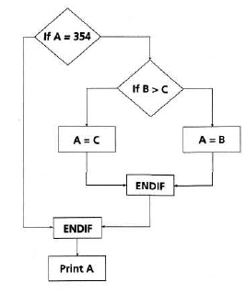
3.3 Static Analysis By Tools – Cyclomatic Complexity
STATIC TECHNIQUES
IF A = 354
THEN IF B > C
THEN A = B
ELSEA= C
ENDIF
ENDIF
Print A
How to calculate the Cyclomatic Complexity:
Formula 1: M=E-N + 2P
M= Complexity
E= no. of edges
N= no. of nodes in the graph
P = no. of disconnected paths
In this case, E=8, N=7 P=1, so M=3
Formula 2: Another simple technique uses the presence of decision points:
complexity = 1 + the no. of decision points
In this case decision points = 2 So, M = 3

Slide 51
3.3.3 Code Structure
STATIC TECHNIQUES
control flow structure: addresses the sequence in which the instructions are executed.
Reflects the iterations and loops in a program's design
Used to identify the dead code
e.g. number of nested levels or cyclomatic complexity
Data flow structure: Follows the trail of a data item as it is accessed and modified by the code
Defects can be found such as referencing a variable with an undefined value and variables that are never used
Data structure : Refers to the organization of the data itself, independent of the program.
- Provides information about the difficulty in writing programs to handle the data and in designing test cases to show program correctness

Slide 52
Sample Questions with answers

Slide 53
4. TEST DESIGN TECHNIQUES

Slide 54
Chapter 4 – Test design techniques (K4)
TEST DESIGN TECHNIQUES
The Chapter covers:
4.1 – The Test Development Process
4.2 - Categories of test design techniques
4.3- Specification-based or black-box techniques
4.4- Structure-based or white-box techniques
4.5- Experience-based techniques
4.6- Choosing a test technique

Slide 55
4.1 The Test development Process- Dynamic Testing
TEST DESIGN TECHNIQUES
This chapter covers the Dynamic testing process where the testing is performed by executing the test by running the code.
Test Conditions, Test Cases and Test Procedures have own ways of describing the data according to IEEE829 (Test Documentation Standard).
Formality of test Documentation:-
- Very formal testing would have Extensive Documentation which is detailed and cover all input and expected output of the test.
- Very informal testing have no documentation.
Notes:
The level of formality generally lies in between and is context dependent. It is also vary organization to organization.
The thoroughness of the documentation is also compromised when project has Time constraints or is under excessive deadline pressure.

Slide 56
4.1.1 Test analysis: identifying test conditions
TEST DESIGN TECHNIQUES
Test Analysis:
It is a process for deriving test information by viewing any basis. This basis is called as Test Basis.
Test basis can be –
- System Requirement
- A Technical specification
- The code itself (for structural testing)
- A business process
Test Conditions:
The test basis includes whatever the test are based on. For testing test basis is used to derive what could be tested. These are called as Test Conditions.
Test Possibilities
- When identifying test conditions we need to identify as many as we can, Process of selecting the test conditions to be developed and combined into the test cases from the bunch of test conditions is called as Test Possibilities.
Notes:
E.g. of Test Conditions:
Code itself is a test basis, when we measure coverage of the code decisions (branches).The decision outcomes (true and false) will be the test conditions.
- Selecting the test condition will also depend on the test strategy or detailed test approach

Slide 57
4.1.2 Traceability
TEST DESIGN TECHNIQUES
It is the ability to identify the related items in the documentation and software such as requirements with associated test. Test conditions should be able to be linked back to their sources in the test basis.
Importance of Traceability:
- The requirement has been changed
- The functional tested in the past is now having serious problem. Traceability between the test and the test basis will help to identify which tests needs to rerun
- Before a new release, we want to know whether we have tested all of the specified requirements
Test Design Specification Template
A document specifying the test conditions(coverage item) for a test item, the detailed test approach and the associated high level test cases.
Test design specification identifier
Features to be tested Approach
refinements Test identification Feature
pass/fail criteria
Notes:
Test Data:
Data that exists before a test is executed and that affects or is affected by the component or system under test.

Slide 58
4.1.3 Test Design: Specifying Test Cases
TEST DESIGN TECHNIQUES
Test Case Specification Template
A document specifying a set of test cases (objective, inputs, test actions, expected results and execution precondition) for a test items
Test case specification identifier
Output specifications
Test items
Environmental needs
Input specifications
Special procedural requirements
Inter case dependencies
Test Oracle
A source to determine expected result to compare with the actual result of the software under test. An oracle may be a requirements specification, the existing system(for a benchmark), a user manual, or an individual's specialized knowledge but should not be the code
Notes:
- Note that one test case covers a number of conditions
- Test cases can be documented as described in the IEEE 829 Standard for Test Documentation
Ideally expected results should be predicted before the test is run
Test Cases:
A set of input values, execution, preconditions, expected results and execution post conditions, developed for the particular objective or test conditions , such as to exercised a particular program path or to verify compliance with a specific requirement.
Test Oracle: Source of information which contain the information about the correct behavior of the software/system is also termed as oracle.
It comes from ancient greek Oracle at delphi, who supposedly could predict the future Inaccuracy

Slide 59
4.1.4 Test Implementation: Specifying test procedures or scripts
TEST DESIGN TECHNIQUES
Test Procedure Specification Template
The Test cases are developed, implemented, prioritized and organized in this document. A document specifying a sequence of action for the execution of a test.
- Test procedure specification identifier
- Purpose
- Special requirements
Procedure steps
Test Script:
Commonly used to refer to a test procedure specifications especially an automated one.

Slide 60
4.2 Categories of Test Design Techniques
TEST DESIGN TECHNIQUES
As Exhaustive testing is impractical, test case design techniques will help us to select test cases more intelligently
What is a testing technique?
A procedure for selecting or designing tests
Based on a structural or functional model of the software
- Successful at finding faults
- Best' practice
- A way of deriving good test cases
A way of objectively measuring a test effort
Advantages of techniques:
- Different people: similar probability find faults
Effective testing: find more faults
Efficient testing: find faults with less effort
Notes:
A testing technique helps us select a good set of tests from the total number of all possible tests for a given system.
Each technique provides a set of rules or guidelines for the tester to follow in identifying test conditions and test cases.

Slide 61

4.2.1 Four types of systematic technique
TEST DESIGN TECHNIQUES
Static (non-execution)
Examination of documentation, source code
listings, etc.
Specification Based (Black Box) testing
Based on behaviour /functionality of software
Structured based (White Box) testing
- Based on the structure of the software
Experience-based testing techniques
- Based on Experienced of the person

Slide 62
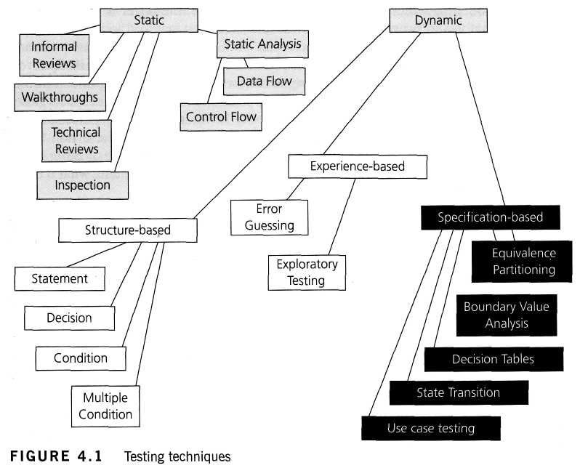
4.2.2 Types of Testing Techniques
TEST DESIGN TECHNIQUES
Notes:
Defined in BS 7925-2 standard:
Following are the specification-based techniques and are
• Equivalence Partitioning
• Boundary Value Analysis
• Decision Tables
• State Transition Testing
• Use Case testing
White Box test design and measurement techniques
Statement testing
Branch / Decision testing
Data flow testing
Branch condition testing
Branch condition combination testing
Modified condition decision testing
LCSAJ testing

Slide 63
4.3 Equivalence Partitioning- Specification Based (Black Box) testing
TEST DESIGN TECHNIQUES
Partition the domain of input values into groups called equivalence classes.
Equivalence classes are chosen such that testing one element in the class is equivalent to testing any other element in the class.
Valid equivalence classes represent valid inputs to the method. Invalid equivalence classes represent all other inputs (i.e., those that violate the precondition)
Invalid inputs are program errors and should not be tested.
invalid
valid
invalid
0
1
100
101
Notes:
No rules for identifying equivalence classes, but there are some guidelines:
- If an input condition specifies a range of values, identify a valid equivalence class for that range.
- If an input condition specifically lists the number of values, identify one valid equivalence class for these values.
- If an input condition specifies a set of input values and there is reason to believe that each is handled differently by the program, identify one valid equivalence class for each element in the set.
- If an input condition specifies a “must be” situation, identify a valid equivalence class for it.
- If there is any reason to believe that elements in an equivalence class are not handled in an identical manner by the program, split the equivalence class into smaller equivalence classes.

Slide 64
4.3.1 Example of Equivalence Partitioning
TEST DESIGN TECHNIQUES
In a computer store, the computer item can have a quantity between -500 to +500. What are the equivalence classes?
Answer:
Valid class: -500 <= QTY <= +500 Invalid class: QTY > +500 Invalid class: QTY < -500
2. Bank account can be integer in the following ranges: 500 to 1000 or 0 to 499 or 2000. What are the equivalence classes?
Answer:
valid class: 0 <= account <= 499
valid class: 500 <= account <= 1000
valid class: 2000 <= account <= 2000
invalid class: account < 0
invalid class: 1000 < account < 2000
invalid class: account > 2000

Slide 65
4.3.2 Boundary Value Analysis
TEST DESIGN TECHNIQUES
Divide the input space into equivalence classes and select a test case from each class.
Boundary value analysis focuses on selecting data near the edges of conditions on both input space and output space.
Faults tend to lurk near boundaries
Test values on both sides of boundaries
invalid
valid
invalid
0
1
100
101
Notes:
General guidelines:
If an input or output condition specifies a range of values, write test cases for the ends of the range.
If an input or output condition specifies a number of values, write test cases for the minimum and maximum number of values.
If the input or output of a procedure is an ordered set, focus attention on the first and last elements of the set.

Slide 66
Example of Boundary value analysis
TEST DESIGN TECHNIQUES
Bank account can be integer in the following ranges: 500 to 1000 or 0 to 499 or 2000. What are the equivalence classes?
Answer:
# | Boundary Value | Result
1 | -1 | Invalid
2 | 0 | Valid
3 | 500 | Valid
4 | 1999 | Invalid
5 | 2000 | Valid
6 | 2001 | Invalid

Slide 67
Example of Boundary value analysis Continued..
TEST DESIGN TECHNIQUES
2. A store in city offers different discounts depending on the purchases made by the individual. In order to test the software that calculates the discounts, we can identify the ranges of purchase values that earn the different discounts. For example, if a purchase is in the range of $1 up to $50 has no discounts, a purchase over $50 and up to $200 has a 5% discount, and purchases of $201 and up to $500 have a 10% discounts, and purchases of $501 and above have a 15% discounts.
Answers:
Boundary values for Invalid partition: 0.00 Boundary values for valid partition(No Discounts): 1, 50 Boundary values for valid partition(5% Discount): 51, 200 Boundary values for valid partition(10% Discount): 201,500 Boundary values for valid partition(15% Discount): 501, Max allowed number in the software application

Slide 68
4.3.3 Decision Tables Testing
TEST DESIGN TECHNIQUES
Explore combinations of inputs, situations or events,
It is very easy to overlook specific combinations of input start by expressing
the input conditions of interest so that they are either TRUE or FALSE
Also referred as Cause-effect table
The coverage standard commonly used with decision table testing is to have
at least one test per column in the table, which involves covering all
combinations of triggering conditions.

Slide 69
Example of Decision Table:

Slide 70
4.3.4 State Transition Testing
TEST DESIGN TECHNIQUES
A state transition table is a table showing what state (or states in the case of a
nondeterministic finite automaton) a finite semi automaton or finite state machine
will move to, based on the current state and other inputs.
It is a techniques in which test cases are designed to execute valid and invalid
state transition
State table:
A grid showing transition for each state combined with each possible event,
showing both valid and invalid transitions
A state table is essentially a truth table in which some of the inputs are the current
state, and the outputs include the next state, along with other outputs.
Two Types : One Dimensional and Two Dimensional State tables
Notes:
One Dimensional State Table or Characteristic Tables
Single-dimension state tables are much more like truth tables than the two-dimensional versions. Inputs are usually placed on the left, and separated from the outputs, which are on the right. The outputs will represent the next state of the machine.
Two Dimensional State tables: There are two common forms for arranging them.
1. The vertical (or horizontal) dimension indicates current states, the horizontal (or vertical) dimension indicates events, and the cells (row/column intersections) in the table contain the next state if an event happens (and possibly the action linked to this state transition).
2. The vertical (or horizontal) dimension indicates current states, the horizontal (or vertical) dimension indicates next states, and the row/column intersections contain the event which will lead to a particular next state.

Slide 71
One dimensional State Table:
TEST DESIGN TECHNIQUES
Also called characteristic tables, single-dimension state tables are much more like truth tables than the two-dimensional versions. Inputs are usually placed on the left, and separated from the outputs, which are on the right. The outputs will represent the next state of the machine. A simple example of a state machine with two states and two combinational inputs follows:
A | B | Current State | Next State | Output
0 | 0 | S₁ | S₂ | 1
0 | 0 | S₂ | S₁ | 0
0 | 1 | S₁ | S₂ | 0
0 | 1 | S₂ | S₂ | 1
1 | 0 | S₁ | S₁ | 1
1 | 0 | S₂ | S₁ | 1
1 | 1 | S₁ | S₁ | 1
1 | 1 | S₂ | S₂ | 0
S₁ and S₂ would most likely represent the single bits 0 and 1, since a single bit can only have two states.

Slide 72
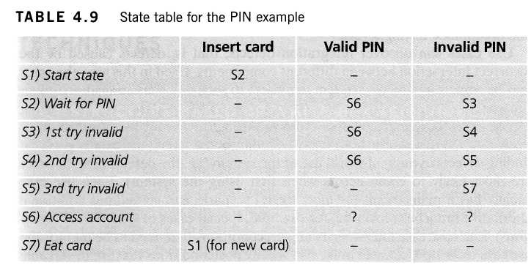
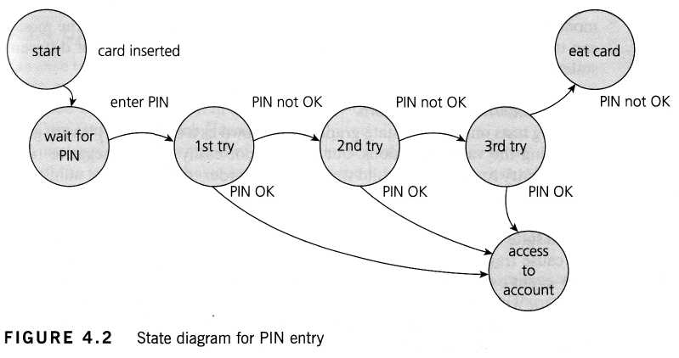
Example of State Transition Two Dimensional
TEST DESIGN TECHNIQUES
Example of entering a Personal Identity Number (PIN) to a bank account:
The states are shown as circles, the transitions as lines with arrows and the events as the text near the transitions. (We have not shown the actions explicitly on this diagram, but they would be a message to the customer saying things such as 'Please enter your PIN'.)

Slide 73
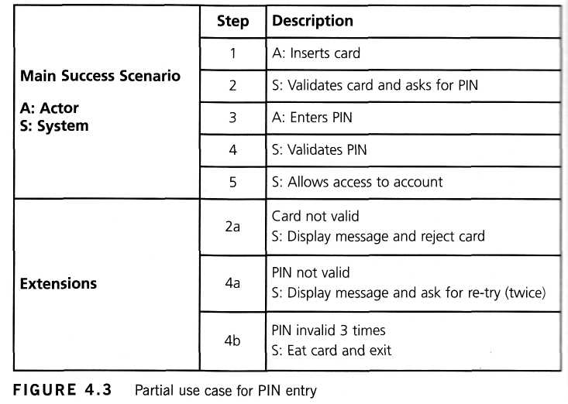
4.3.5 Use case testing
TEST DESIGN TECHNIQUES
A Black Box test design technique in which test case are designed to execute user
scenarios
A use case is a description of a particular use of the system by an actor (a user of the
system).
Each use case describes the interactions the actor has with the system in order to
achieve a specific task (or, at least, produce something of value to the user).
Each use case must specify any preconditions that need to be met for the use case
to work and also must specify post conditions that are observable results and a
description of the final state of the system after the use case has been executed
successfully.
E.g. of Use Case:

Slide 74
4.4 Structure-based or white-box techniques (K4)
TEST DESIGN TECHNIQUES
The section covers:
4.4.1 Using structure-based techniques to measure coverage and design tests
4.4.2 Statement coverage and statement testing
4.4.3 Decision coverage and decision testing
4.4.4 Other structure-based techniques

Slide 75
4.4.1 Using structure-based techniques to measure coverage and design tests(K4)
TEST DESIGN TECHNIQUES
Structure-based techniques serve two purposes: test coverage measurement and structural test case design
They can help ensure more breadth of testing, in the sense that test cases that achieve 100% coverage in any measure will be exercising all parts of the software from the point of view of the items being covered.
What is test coverage?
Number of coverage items exercised
Coverage = --------------------------------------------------- x 100%
Total number of coverage items

Slide 76
4.4.1 Using structure-based techniques to measure coverage and design tests(K4)
TEST DESIGN TECHNIQUES
.
Types of coverage : Coverage can be measured at component-testing level, integration-testing level or at system- or acceptance-testing levels
EP: percentage of equivalence partitions exercised (we could measure valid and invalid partition coverage separately if this makes sense)
BVA: percentage of boundaries exercised (we could also separate valid and invalid boundaries if we wished)
Decision tables: percentage of business rules or decision table columns tested

Slide 77
4.4.1 Using structure-based techniques to measure coverage and design tests(K4)
TEST DESIGN TECHNIQUES
State transition testing: there are a number of possible coverage measures:
- Percentage of states visited
- Percentage of (valid) transitions exercised (this is known as Chow's 0- switch coverage)
- Percentage of pairs of valid transitions exercised ('transition pairs' or
(how's 1-switch coverage) - and longer series of transitions, such as transition triples, quadruples, etc.
- Percentage of invalid transitions exercised (from the state table)
How to measure coverage
- Decide on the structural element to be used, i.e. the coverage items to be counted.
- Count the structural elements or items.
- Instrument the code.
- Run the tests for which coverage measurement is required.
- Using the output from the instrumentation.

Slide 78
4.4.1 Using structure-based techniques to measure coverage and design tests(K4)
TEST DESIGN TECHNIQUES
Structure-based test case design :
- If you are aiming for a given level of coverage (say 95%) but you have not reached your target (e.g. you only have 87% so far), then additional test cases can be designed with the aim of exercising some or all of the structural elements not yet reached.
- These new tests are then run through the instrumented code and a new coverage measure is calculated.
- This is repeated until the required coverage measure is achieved (or until you decide that your goal was too ambitious!).

Slide 79
4.4.2 Statement coverage and statement testing(K4)
TEST DESIGN TECHNIQUES
Statement Coverage
Number of statements exercised
Statement coverage = --------------------------------------------- x 100%
Total number of statements
Statement coverage is determined by the number of executable statements covered by(Designed or executed) test cases divided by the number of all executable statements in the code under test.
Notes:
For example, consider code sample 4.1.
READ A
READB
IFA>BTHENC = 0
ENDIF
Code sample 4.1
To achieve 100% statement coverage of this code segment just one test case is required, one which ensures that variable A contains a value that is greater
than the value of variable B, for example, A = 12 and B = 10. Note that here we are doing structural test design first, since we are choosing our input values in order ensure statement coverage.

Slide 80
4.4.3 Decision coverage and decision testing (K4)
TEST DESIGN TECHNIQUES
Decision Coverage
Number of decision outcomes exercised
Decision coverage = -------------------------------------------------------- x 100%
Total number of decision outcomes
Decision coverage, related to branch testing, is the assessment of the percentage of decision outcomes that have been executed by a test suite.
Decision coverage is determined by the number of all decision outcomes covered by test cases divided the number of all possible decision outcomes in the code under test.
Decision testing a form of control flow testing as it follows a specific flow of control through the decision points
Decision coverage is stronger than statement coverage, 100% decision coverage guarantees 100% statement coverage, but not vice versa.

Slide 81
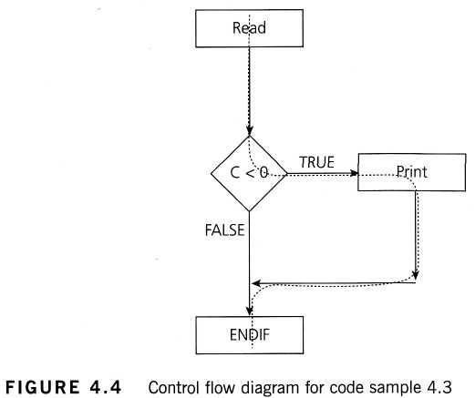
4.4.3 Decision coverage and decision testing (K4)
TEST DESIGN TECHNIQUES
Notes:
Which decision outcomes have we exercised with our test? The value of C is -10, so the condition 'C < 0' is True, so we will print 'C negative' and we have exercised the True outcome from that decision statement. But we have not exercised the decision outcome of False. What other test would we need to exercise the False outcome and to achieve 100% decision coverage?
Before we answer that question, let's have a look at another way to represent this code. Sometimes the decision structure is easier to see in a control flow diagram (see Figure 4.4).
The dotted line shows where Test 2_1 has gone and clearly shows that we haven't yet had a test that takes the False exit from the IF statement.
Let's modify our existing test set by adding another test:
TEST SET 2
Test 2_1: A = 20, B = 15
Test 2_2: A = 10, B = 2
This now covers both of the decision outcomes, True (with Test 2_1) and False (with Test 2_2). If we were to draw the path taken by Test 2_2, it would be a straight line from the read statement down the False exit and through the ENDIF. Note that we could have chosen other numbers to achieve either the True or False outcomes.

Slide 82
4.4.3 Example of Coverage
TEST DESIGN TECHNIQUES
Notes:
Which decision outcomes have we exercised with our test? The value of C is -10, so the condition 'C < 0' is True, so we will print 'C negative' and we have exercised the True outcome from that decision statement. But we have not exercised the decision outcome of False. What other test would we need to exercise the False outcome and to achieve 100% decision coverage?
Before we answer that question, let's have a look at another way to represent this code. Sometimes the decision structure is easier to see in a control flow diagram (see Figure 4.4).
The dotted line shows where Test 2_1 has gone and clearly shows that we haven't yet had a test that takes the False exit from the IF statement.
Let's modify our existing test set by adding another test:
TEST SET 2
Test 2_1: A = 20, B = 15
Test 2_2: A = 10, B = 2
This now covers both of the decision outcomes, True (with Test 2_1) and False (with Test 2_2). If we were to draw the path taken by Test 2_2, it would be a straight line from the read statement down the False exit and through the ENDIF. Note that we could have chosen other numbers to achieve either the True or False outcomes.

Slide 83
4.4.4 Other structure-based techniques(K1)
TEST DESIGN TECHNIQUES
There are stronger level of structural coverage beyond decision coverage, for example condition coverage and multiple condition coverage.
This technique requires the coverage of all conditions that can affect or determine the decision outcome
The concept of coverage can also be applied at other test levels. For example, at the integration level the percentage of modules, components or classes that have been exercised by a test case suite could be expressed as a module, component or class coverage.

Slide 84
4.5 Experience Based Techniques(K2)
TEST DESIGN TECHNIQUES
The section covers:
4.5.1 Error Guessing
4.5.2 Exploratory Testing

Slide 85
4.5.1 Error Guessing
TEST DESIGN TECHNIQUES
Error guessing is a technique that should always be used as a complement to
other more formal techniques.
The success of error guessing is very much dependent on the skill of the tester, as good testers know where the defects are most likely to lurk.
This is why an error-guessing approach, used after more formal techniques have been applied to some extent, can be very effective.
There are no rules for error guessing. The tester is encouraged to think of situations in which the software may not be able to cope.
A structured approach to the error-guessing technique is to list possible defects or failures and to design tests that attempt to produce them.

Slide 86
4.5.2 Exploratory Testing
TEST DESIGN TECHNIQUES
Exploratory testing is a hands-on approach in which testers are involved in
minimum planning and maximum test execution.
The planning involves the creation of a test charter, a short declaration of the
scope of a short (1 to 2 hour) time-boxed test effort, the objectives and possible
approaches to be used.
The test design and test execution activities are performed in parallel typically
without formally documenting the test conditions, test cases or test scripts.
Test logging is undertaken as test execution is performed, documenting the key
aspects of what is tested, any defects found and any thoughts about possible
further testing.
A key aspect of exploratory testing is learning: learning by the tester about the
software, its use, its strengths and its weaknesses.
This is an approach that is most useful when there are no or poor specifications
and when time is severely limited. It can also serve to complement other, more
formal testing, helping to establish greater confidence in the software

Slide 87
4.6 Choosing a Test Technique(K2)
TEST DESIGN TECHNIQUES
This section covers that how can we choose the most appropriate testing
techniques to use. The decision will be based on a number of factors, both
internal and external.
The internal factors that influence the decision about which technique to use are:
- Models used
- Tester knowledge I experience
- Likely defects
- Test objective
- Documentation
- Life cycle model
The external factors that influence the decision about which technique to use
are:
- Risk
- Customer contractual requirements
- Type of system
- Regulatory requirements
- Time and budget

Slide 88
Sample Questions with answers

Slide 89
5. TEST MANAGEMENT

Slide 90
5.1.1 Independent and Integrated Testing
5.1 TEST ORGANIZATION
It is the degree of independence to which testing is performed.
Levels of Test Independence:
Independent testers within the development teams.
Independent test team or group within the organization, reporting to project management or executive management.
Independent testers from the business organization, user community and IT.
Independent test specialists for specific test targets such as usability testers, security testers or certification testers
Independent testers outsourced or external to the organization

Slide 91
5.1.1 Independent and Integrated Testing cntd…
5.1 TEST ORGANIZATION
Benefits
Independent testers uncover different defects, and are unbiased
An independent tester can verify assumptions made during specification and implementation of the system
Usually a Cost saving
Better skills, more effective testing and fewer defects getting into production
Drawbacks
Isolation from the development team (if treated as totally independent).
Can be the bottleneck as the last checkpoint
Developers lose a sense of responsibility for quality
Can be a greater cost – need to consider viability
For Third Party test outsourcing, the project carries the risk

Slide 92
5.1.2 Working as a Test Leader
5.1 TEST ORGANIZATION
Strategy & Management
Write and review the test strategy
Plan testing effort – context, risks & approach
Proactive representation in other project activities – ensure testing has correct focus
Ensure proper configuration management of Testware exists
Determine what should be automated
Select and implement the most appropriate tools for testing including necessary training
Management and definition of the test environmental requirements
Define the test schedule based on the delivery of code in to test
Monitor
Define, record and continually review the testing project metrics
Monitor test progress against the test schedule
Write the test summary reports
Control
Adapt testing effort based results and progress
Notes:
Test Leader: The Person responsible for the management of testing activities and resources. The individual who directs control, administers, plan and regulate the evaluation of a test object.

Slide 93
5.1.2 Working as a Tester
5.1 TEST ORGANIZATION
Review and contribute to test plans
Analyze, review and assess user requirements, specifications and models for testability
Create, review Test specifications
Set up the test environment
Define, prepare and acquire test data
Implement tests on all test levels, execute and log the tests
Evaluate the results and document the deviations (defects/issues) from expected results
Use various test tools as required
Automate tests
Notes:
Tester: A skilled Professional who is involved in the testing of component or system

Slide 94
5.2.1 The Purpose and Substance of Test Plan
5.2 TEST PLANING AND ESTIMATION
Why do we write Test plan?
The Test plan guides our thinking and forces us to confront the challenges that await us
The Test plan itself serve as vehicles for communicating with project team members
The Test plan helps us manage changes
The Test plan becomes a record of previous discussions and agreements between the testers and the rest of the project team
There can be different Test plans for different Test levels
Notes:
Test Plan: A document Describing the Scope, approach, resources and schedule of the intended test activities. It identifies, amongst other, test items, the features to be tested, the testing task, the degree of tester independence, the test environment, the test design technique, the entry exit criteria to be used and the rationale for their choice and any risk requiring contingency planning. it is record of the test planning process.
Test Level: A group of test activities that are organized and managed together. A test level is linked to the responsibilities in a project.

Slide 95
5.2.1 Test Plan Contents (IEEE 829)
5.2 TEST PLANING AND ESTIMATION
Test Plan Identifier
Introduction
Test Items
Features to be Tested
Features not to be Tested
Approach
Item Pass/Fail Criteria
Suspension Criteria and Resumption Requirements
Test Deliverables
Testing Tasks
Environmental Needs
Responsibilities
Staffing and Training Needs
Schedule
Planning Risks and Contingencies
Approvals

Slide 96
5.2.2 Test Planning Activities
5.2 TEST PLANING AND ESTIMATION
Determining the scope, risks and identifying the objectives of testing
Defining the overall approach of testing, including the definition of the test levels, entry and exit criteria
Integrating and coordinating the testing activities into the software life cycle activities (acquisition, supply, development, operation and maintenance)
Making decisions about what to test, what roles will perform the test activities, how the test activities should be done, and how the test results will be evaluated
Scheduling test analysis and design activities
Scheduling test implementation, execution and evaluation
Assigning resources for the different activities defined
Defining the amount, level off detail, structure and templates for the test documentation
Selecting metrics for monitoring and controlling test preparation and execution, defect resolution and risk issues
Setting the level of detail for test procedures in order to provide enough information to support reproducible test preparation and execution

Slide 97
5.2.3 & 5.2.4 Entry and Exit Criteria
5.2 TEST PLANING AND ESTIMATION
Entry Criteria:
The set of generic and specific conditions for permitting a process to go forward with a define task.
The purpose of entry criteria is to prevent a task from starting which would entail more (wasted) effort compare to the effort needed to remove the failed entry criteria.
Exit Criteria:
The Set of generic and specific conditions, agreed upon with the stakeholders, for permitting a process to be officially completed.
The Purpose of exit criteria is to prevent a task from being completed when there are still outstanding parts which are not finished yet.
Exit criteria are used to report against and to plan when to stop testing.
Notes:
Added New Slide:
Entry criteria may cover the following:
Test environment availability and readiness
Test tool readiness in the Test environment
Testable code availability
Test data availability
Exit criteria may cover the following:
Thoroughness measures, such as coverage of code functionality or risk
Estimates of defect density or reliability measures
Cost
Residual Risks, such as defects not fixed or lack of test coverage in certain areas.
Schedules such as those based on time to market

Slide 98
5.2.3 & 5.2.4 Entry and Exit Criteria
5.2 TEST PLANING AND ESTIMATION
Test
Phase 2
is it ready for my testing?
"tested"
Test
Phase 1
Phase 2
Phase 1
Entry criteria
Exit criteria
Acceptance criteria
Completion criteria
Notes:
Added New slide

Slide 99
5.2.5 Estimation Techniques
5.2 TEST PLANING AND ESTIMATION
Work breakdown structure (WBS) – Breaking down the large activities and tasks into smaller, more manageable tasks.
Bottom-up estimation - Estimate for efforts, duration, dependencies etc for lowest level tasks from WBS and roll-up to arrive total estimate
Top-down estimation - Deriving estimates from similar projects
Parametric technique – Estimating based on some parameters. E.g. average effort per test case

Slide 100
5.2.5 Factors affecting Test Effort
5.2 TEST PLANING AND ESTIMATION
Characteristics of the product:
The quality of the specification
The size of the product
The complexity of the problem domain
Characteristics of the development process:
The stability of the organization
Tools used
Test process
Skills of the people involved
Time pressure
The outcome of testing:
The number of defects
The amount of rework required

Slide 101
5.2.6 Test Approaches or Strategies
5.2 TEST PLANING AND ESTIMATION
Analytical approaches - such as risk-based testing where testing is directed to areas of greatest risk
Model-based approaches - such as random testing using statistical information about failure rates (such as reliability growth models)
Methodical approaches - such as failure based (including error guessing and fault-attacks), check-list based, and quality characteristic based
Process or standard-compliant approaches - such as those specified by industry-specific standards or the various agile methodologies
Dynamic and heuristic approaches - such as exploratory testing where testing is more reactive to events than pre-planned, and where execution and evaluation are concurrent tasks
Consultative or directed approaches - such as those where test coverage is driven primarily by the advice and guidance of technology and/or business domain experts outside the test team
Regression-averse approaches - such as those that include reuse of existing test material, extensive automation of functional regression tests and standard test suites

Slide 102
5.2.6 Choosing The Right Approach
5.2 TEST PLANING AND ESTIMATION
The selection of a test approach should consider the context, including:
Risk of failure of the project, hazards to the product and risks of product failure to humans, the environment and the company
Skills and experience of the people in the proposed techniques, tools and methods
The objective of the testing endeavor and the mission of the testing team
Regulatory aspects, such as external and internal regulations for the development process
The nature of the product and the business

Slide 103
5.3.1 Monitoring The Progress
5.3 TEST PROGRESS MONITORING AND CONTROL
Why Test monitoring is necessary?
To know the status of the testing project at any given point in time
To provide visibility on the status of testing to other stake holders
To be able to measure testing against defined exit criteria
To be able to assess progress against Planned schedule & Budget
IEEE 829 Standard: Test Log Template Content
Test Log identifier
Description (items being tested, environment in which the testing is conducted)
Activity and event entries (execution description, procedure results, environmental information, anomalous events, incident report identifiers)

Slide 104
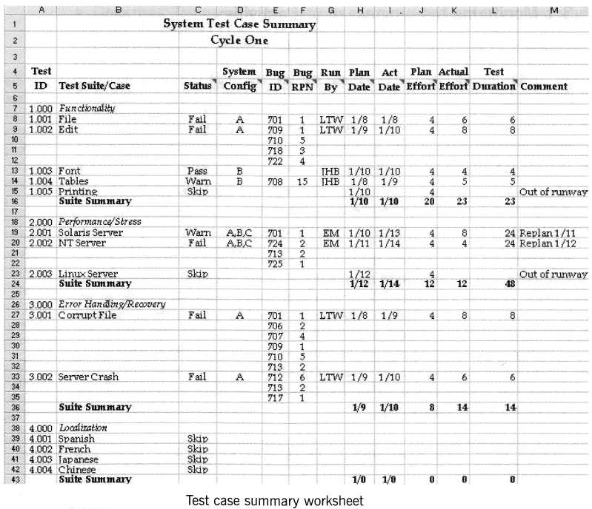
Example: Test Case Summary Worksheet
5.3 TEST PROGRESS MONITORING AND CONTROL

Slide 105
5.3.1 Metrics For Test Progress
5.3 TEST PROGRESS MONITORING AND CONTROL
Metrics should be collected during and at the end of a test level. They are also valuable input into process improvement. Common metrics for test progress monitoring include:
The extent of completion of test environment preparation
The extent of test coverage achieved, measured against requirements, risks, code, configurations or other areas of interest
The status of the testing compared to various test milestones
The economics of testing, such as the costs and benefits of continuing test execution in terms of finding the next defect or running the next test.

Slide 106
5.3.2 Reporting Test Status
5.3 TEST PROGRESS MONITORING AND CONTROL
Reporting test status is about effectively communicating our findings to other project stakeholders. It is usually done through Test Summary Report
IEEE 829 Standard: Test Summary Report Template
Test summary report identifier
Summary
Variances
Comprehensive assessment
Summary of results
Evaluation
Summary of activities
Approvals

Slide 107
5.3.3 Test Control
5.3 TEST PROGRESS MONITORING AND CONTROL
Test control is the response to Test Monitoring and Test Reporting that allows us to be IN CONTROL of the project
Issues need to monitored and reported
The process of control is the corrective actions required to put a testing effort (project) back on track
For Example:
Re-prioritize tests when an identified risk
Change the test schedule based on availability of a test environment

Slide 108
5.4 Configuration Management and Configuration control
5.4 CONFIURATION MANAGEMENT
Configuration Management:
A discipline applying technical and administrative direction and surveillance to identify and document the functional and physical characteristics of a configuration item
Configuration Control or Version control:
An element of configuration management, consisting of evaluation, coordination, approval or disapproval and implementation of changes to configuration items after formal establishment of their configuration identification
Notes:
Added new slide

Slide 109
5.4 Products for Configuration Management in Testing
5.4 CONFIURATION MANAGEMENT
Test plans
Test designs
Test cases:
Test input
Test data
Test scripts
Expected results
Actual results
Test tools
What would not be under configuration management?
Live data
Notes:
Added new slide

Slide 110
5.5 Risk and Testing
5.5 RISK AND TESTING
Risk:
A factor that could result in negative consequences; usually expressed as impact and like hood
Risks are used to decide where to start testing and where to test more.
Risked Based testing:
Testing oriented towards exploring and providing information about product risks
Risk based Testing is used to reduce risk of adverse effect occurring or to reduce the impact of adverse effect
It draws on the collective knowledge and insight of the project stakeholders to determine the risk and the level of testing required to address those risks.
Notes:
Added new slide
Risk identified in the Risked Based testing is used to:
- Determine the test techniques to be employed
- Determine the extent of testing to be carried out
- Prioritize testing in an attempt to find the critical defect as early as possible
- Determine whether any non testing activities could be employed to reduce risk
Risk Management activities provide a discipline approach to minimize the product failure:
- Assess and reassess what can go wrong (risks)
- Determine what risks are important to deal with
- Implement action to deal with those risks

Slide 111
5.5.1 Project Risks
5.5 RISK AND TESTING
Project Risk
A risk related to management and control of the (test) project is called as Project Risk.
Project risk are:
Organizational factor
Skill, training and staff shortage
Personnel issues
Political issues
Improper attitude toward or expectation of testing
Technical issues
Problem in defining right requirements and quality of the design code, test data and test
The extent to which requirement cannot be met given existing constraints
Test environment not ready on time or late data conversion, migration planning and development and testing data conversion/migration tools
Supplier issues
Failure of a third party
Contractual issues
Notes:
Added new slide

Slide 112
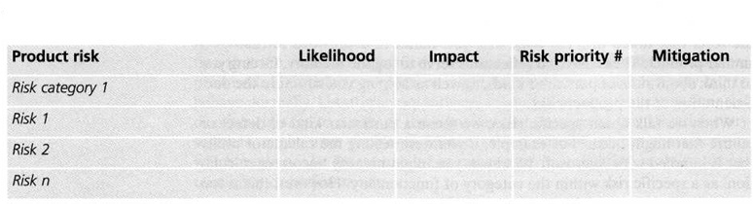
5.5.2 Product Risks
5.5 RISK AND TESTING
Product Risk:
A risk directly related to the test object is called as product risk.
Risk is related to quality of a product:
Failure-prone software delivered
The Potential that the software/hardware could cause harm to an individual or company
Poor software characteristics
Poor data integrity and quality
Software that does not perform its intended functions
Notes:
Added new slide

Slide 113
5.6 Incident Management
5.6 INCIDENT MANAGEMENT
Root cause:
An underlying factor that caused a non conformance and possibly should be permanently eliminated through process improvement.
Defect Report(Bug report):
A document reporting on any flaw in a component or system that can cause the component or system to fail to perform its require function.
Defect Detection Percentage(DDP):
The number of defect found by test phase, divided by the number found by that test phase and any other means afterwards
defects (testers)
DDP= ----------------------------------------------------------
defects (testers) + defects (field)
Notes:
Added new slide

Slide 114
5.6 Priority and Severity
5.6 INCIDENT MANAGEMENT
Priority:
The level of (business) importance assigned to an item
Severity:
The degree of the impact that a defect has on development or operation of a component or system
Examples
Minor cosmetic typo
Crash if this feature is used
company name,
board member:
priority, not severe
Experimental,
not needed yet:
severe, not priority
Notes:
Added new slide

Slide 115
5.6 Incident Logging
5.6 INCIDENT MANAGEMENT
Incident Logging:
Recording the details of any incident that occurred.
Incident report:
A document reporting on any event that has occurred, e.g. during the testing, which requires investigation
Test Incident Report Template:
Test incident report identifier
Summary
Incident description (inputs, expected results, actual results, anomalies, date and time, procedure step, environment, attempts to repeat, testers and observers)
Impact
Notes:
Added new slide

Slide 116
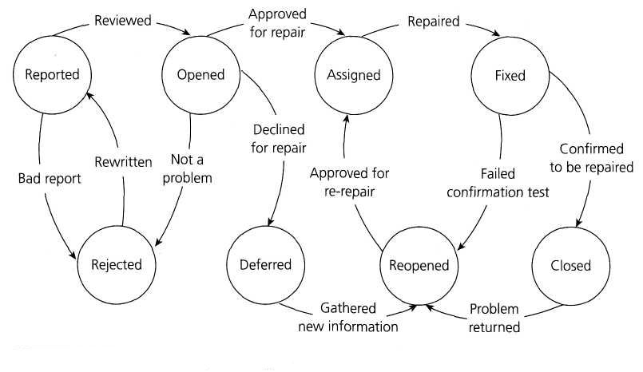
5.6 Incident Lifecycle
5.6 INCIDENT MANAGEMENT
Notes:
Added New slide

Slide 117
Sample Questions with answers

Slide 118
6. TOOL SUPPORT FOR TESTING

Slide 119
6.1.1 Tool Support for Testing
6.1 TYPES OF TEST TOOLS
Test tools can be used for activities that support testing:
Directly used in testing such as test execution
Help in managing the testing process
Used for exploration
Aids in testing such as spreadsheet
Tool support for testing can have following purposes :
Improve the efficiency of test activities by automating or supporting manual test activities
Automate activities that cannot be executed manually or require significant resources
Increase reliability of testing

Slide 120
6.1.2 Test Tools Classification
6.1 TYPES OF TEST TOOLS
Tools can be classified based on several criteria such as
Purpose
Commercial / free / open-source / shareware
Technology used
Tools that support Testing activities
Intrusive Tools - Can affect the actual outcome of the test
E.g. The actual timing may be different due to the extra instructions that are executed by the tool. This is called the Probe effect
Some tools offer support more appropriate for developers
E.g. Tools used for component and component integration testing

Slide 121
6.1.3 Tool Support for Management of Testing and Tests
6.1 TYPES OF TEST TOOLS
Management tools apply to all test activities over the entire software life cycle
Test Management Tools
Provide interfaces for executing tests
Tracking defects
Managing requirements
Support for quantitative analysis
Reporting of the test objects
Tracing the test objects to requirements
Requirements Management Tools
Store requirement statements
Store the attributes for the requirements
Provide unique identifiers
Support tracing the requirements to individual tests
Help to identify inconsistent or missing requirements

Slide 122
6.1.3 Tool Support for Management of Testing and Tests
6.1 TYPES OF TEST TOOLS
Incident Management Tools (Defect Tracking Tools)
Store and manage incident reports
Help in managing the life cycle of incidents, optionally provide support for statistical analysis
Configuration Management Tools
Not strictly test tools but are necessary
Storage and version management of testware in terms of operating system versions, compilers, browsers, etc.

Slide 123
6.1.4 Tool Support for Static Testing
6.1 TYPES OF TEST TOOLS
Review Tools
Assist with review processes, checklists, review guidelines
Used to store and communicate review comments
Report on defects and effort
Help by providing aid for online reviews for large or geographically dispersed teams.
Static Analysis Tools
Help developers and testers find defects prior to dynamic testing
Provide support for enforcing coding standards
Help in planning or risk analysis by providing metrics for the code (e.g., complexity)

Slide 124
6.1.4 Tool Support for Static Testing cntd…
6.1 TYPES OF TEST TOOLS
Modeling Tools
Used to validate software models (e.g., physical data model (PDMM) for a relational database)
Help in finding defects
Aid in generating some test cases based on the model

Slide 125
6.1.5 Tool Support for Test Specification
6.1 TYPES OF TEST TOOLS
Test Design Tools
Generate test inputs or executable tests
Generate test oracles from requirements, graphical user interfaces, design models or code
Test Data Preparation Tools
Manipulate databases, files or data transmissions
Set up test data to be used during the execution of tests
Ensure security through data anonymity

Slide 126
6.1.6 Tool Support for Test Execution & Logging
6.1 TYPES OF TEST TOOLS
Test Execution Tools
Enable tests to be executed automatically or semi-automatically using stored inputs and expected outcomes
Use of a scripting language and usually provide a test log for each test run
Use to record tests, support scripting languages or GUI-based configuration for parameterization and other customization
Test Harness/Unit Test Framework Tools
These tools facilitate the testing of components or parts of a system by simulating the environment in which that test object will run
Provision of mock objects as stubs or drivers

Slide 127
6.1.6 Tool Support for Test Execution & Logging cntd…
6.1 TYPES OF TEST TOOLS
Test Comparators
Determine differences between files, databases or test results
A test comparator may use a test oracle, especially if it is automated
Coverage Measurement Tools
Measure the percentage of specific types of code structures that have been exercised through intrusive or non-intrusive means
E.g., Statements, branches or decisions and module or function calls
Security Testing Tools
Used to evaluate the security characteristics of software
Evaluate the ability of the software to protect data confidentiality, integrity, authentication, authorization, availability, and non-repudiation
Focused on a particular technology, platform and purpose

Slide 128
6.1.7 Tool Support for Performance & Monitoring
6.1 TYPES OF TEST TOOLS
Dynamic Analysis Tools
Find defects that are evident only when software is executing, such as time dependencies or memory leaks
Used in component and component integration testing and when testing middleware
Performance Testing/Load Testing/Stress Testing Tools
Monitor and report on how a system behaves under a variety of simulated usage conditions
The simulation of load is achieved by means of creating virtual users carrying out a selected set of transactions
Monitoring Tools
Continuously analyze, verify and report on usage of specific system resources
Give warnings of possible service problems

Slide 129
6.1.8 Tool Support for Specific Testing Needs
6.1 TYPES OF TEST TOOLS
Data Quality Assessment
Review and verify the data conversion and Migration rules
Verify data against pre-defined context specific standard
Other testing tools exist for usability testing

Slide 130
6.2.1 Potential Benefits and Risks of Tool Support for Testing
6.2 EFFECTIVE USE OF TOOLS: POTENTIAL BENEFITS AND RISKS
Reasons for acquiring tools to support testing:
Doing certain tasks that are better done by a computer than by a person
Ever-shrinking schedule and minimal resources
It involves automating a manual process of testing
Eliminating human error

Slide 131
6.2.1 Potential Benefits of using tools
6.2 EFFECTIVE USE OF TOOLS: POTENTIAL BENEFITS AND RISKS
Reduction of repetitive work
Greater consistency and repeatability
Objective assessment
Ease of access to information about tests or testing

Slide 132
6.2.1 Risks of using tools
6.2 EFFECTIVE USE OF TOOLS: POTENTIAL BENEFITS AND RISKS
Unrealistic expectations for the tool
Under estimating the time, cost and effort for the initial introduction of a tool
Under estimating the time and effort needed to achieve significant and continuing benefits from the tool
Under estimating the effort required to maintain the test assets
Over-reliance on the tool
Poor response from vendor for support, upgrades and defect fixes
Risk of suspension of open-source / free tool project

Slide 133
6.2.2 Special considerations for some types of tools
6.2 EFFECTIVE USE OF TOOLS: POTENTIAL BENEFITS AND RISKS
Test Execution Tools
Often requires significant effort in order to achieve significant benefits.
Capture/playback does not scale to large numbers of automated test
Captured script may be unstable when unexpected events occur
Technical expertise in the scripting languages needed for all approaches
The expected results for each test need to be stored for later comparison
Various types of scripting to be considered
Linear scripts
Structured scripts
Shared scripts
Data-driven scripts
Keyword-driven scripts

Slide 134
6.2.2 Special considerations for some types of tools cntd…
6.2 EFFECTIVE USE OF TOOLS: POTENTIAL BENEFITS AND RISKS
Static analysis tools:
Can identify potential problems in code before the code is executed
Can help to check that the code is written to coding standards
Tools can generate a large number of messages
E.g. By finding the same thing after every few lines
The aim is to produce code that will be easier to maintain in the future
A filter on the output could eliminate less important messages and highlight more important messages

Slide 135
6.2.2 Special considerations for some types of tools cntd…
6.2 EFFECTIVE USE OF TOOLS: POTENTIAL BENEFITS AND RISKS
Test management tools:
These tools can provide a lot of useful information, but the information may not be in the required form
Additional work needed to produce interfaces to other tools
A defined test process needs to be set before test management tools are introduced
If the testing process is working well manually, then a test management tool can help to support the process and make it more efficient
Notes:
Bing-bang - All components or systems are integrated simultaneously, after which everything is tested as a whole.
Top-down: testing takes place from top to bottom, following the control flow or architectural structure (e.g. starting from the GUI or main menu). Components or systems are substituted by stubs.
• Bottom-up: testing takes place from the bottom of the control flow upwards. Components or systems are substituted by drivers.
• Functional incremental: integration and testing takes place on the basis of the functions or functionality, as documented in the functional specification.

Slide 136
6.3 Introducing a tool into an organization
6.3 INTRODUCING A TOOL INTO AN ORGANIZATION
Main Considerations in Selecting a Tool:
Assessment of the organization's maturity
Identification of the areas where tool support will help to improve testing processes
Evaluation of tools against clear requirements and objective criteria
Proof-of-concept to see whether the product works as desired
Evaluation of the vendor or open-source network of support
Identifying and planning internal implementation

Slide 137
6.3 Introducing a tool into an organization cntd…
6.3 INTRODUCING A TOOL INTO AN ORGANIZATION
Pilot Project:
One of the ways to do a proof-of-concept is to have a pilot project as the first thing done with a new tool. This will use the tool on a small scale, with sufficient time to explore different ways of using the tool.
The objectives for a pilot project for a new tool are:
To learn more about the tool (more detail, more depth)
Evaluate how the tool fits with existing processes and practices, and determine scope to change
Decide on standard ways of using, managing, storing and maintaining the tool and the test assets
Assess whether the benefits will be achieved at reasonable cost

Slide 138
6.3 Introducing a tool into an organization continued…
6.3 INTRODUCING A TOOL INTO AN ORGANIZATION
Success factors:
Success is not guaranteed or automatic when implementing a testing tool. Here are some of the factors that have contributed to success
Incremental roll-out (after the pilot) to the rest of the organization
Adapting and improving processes, testware and tool artifacts
Providing adequate training, coaching and mentoring for new users
Defining and communicating guidelines for the use of the tool
Implementing a continuous improvement mechanism
Monitoring the use of the tool, benefits achieved and lessons learned

